Slide 1


Fixed Assets Operations in Oracle E-Business Suite (EBS)
Students names:
Omar Hassan
Omar Soliman
Mostafa Eltaweel
Ahmed Ramadan
Track: Oracle Digital Accounting Specialist
Supervisor name: Mohamed Sobhy
09/04/2025

Slide 2
Introduction
This project focuses on implementing the Fixed Assets module in Oracle E-Business Suite (EBS) to automate and streamline financial processes.
This will help reduce errors, improve compliance, and speed up period-end closing, making the process more efficient and reliable for organizations.

Slide 3
Fixed Assets Operations and Reporting in Oracle ERP
1- Adding New Assets
2- Managing Assets
3- Period-End Closing and Reporting

Slide 4
Adding New Assets
Adding new assets manually.
Adding new assets through mass additions.
Assets integration with the AP Module.

Slide 5
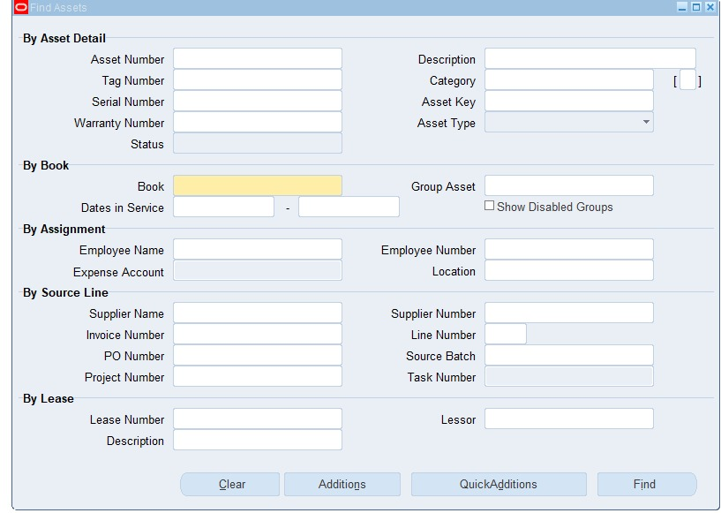

Slide 6
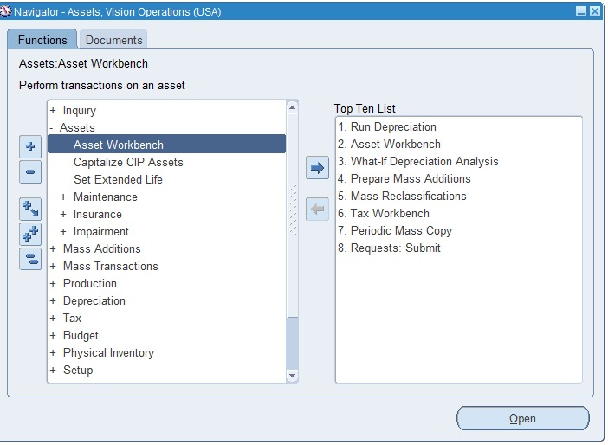

Slide 7
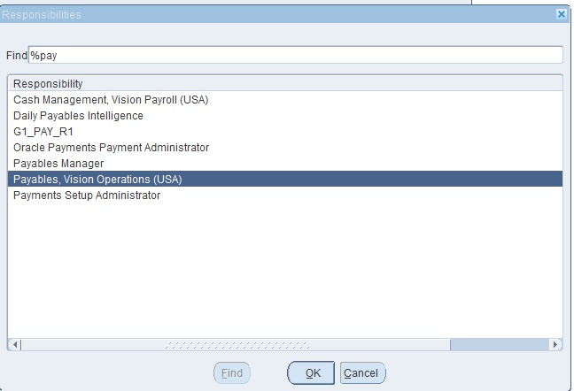

Slide 8
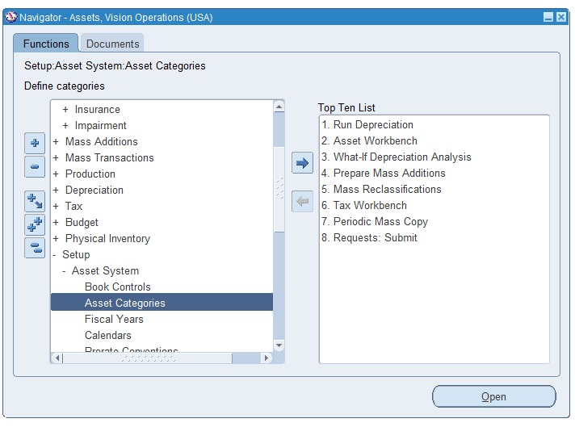

Slide 9
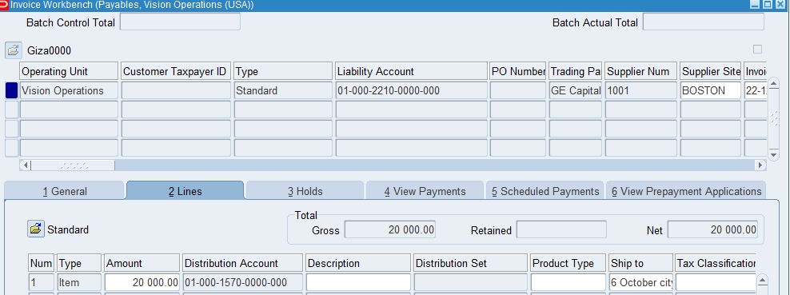

Slide 10
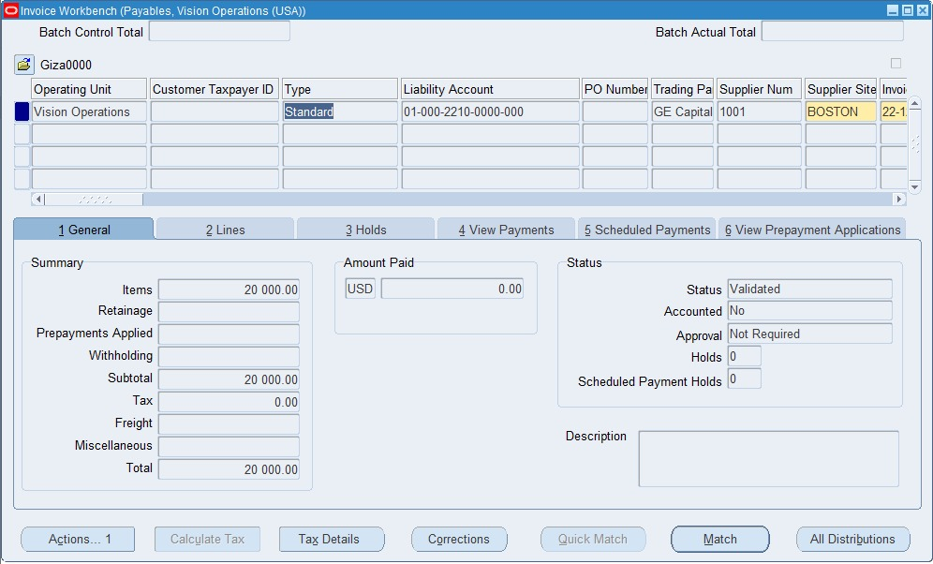

Slide 11
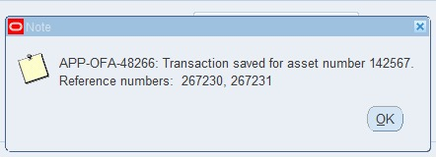

Slide 12
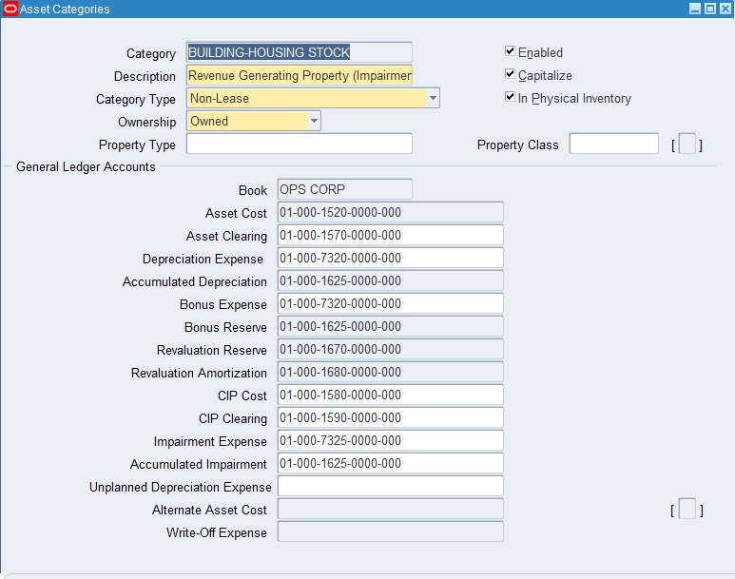

Slide 13
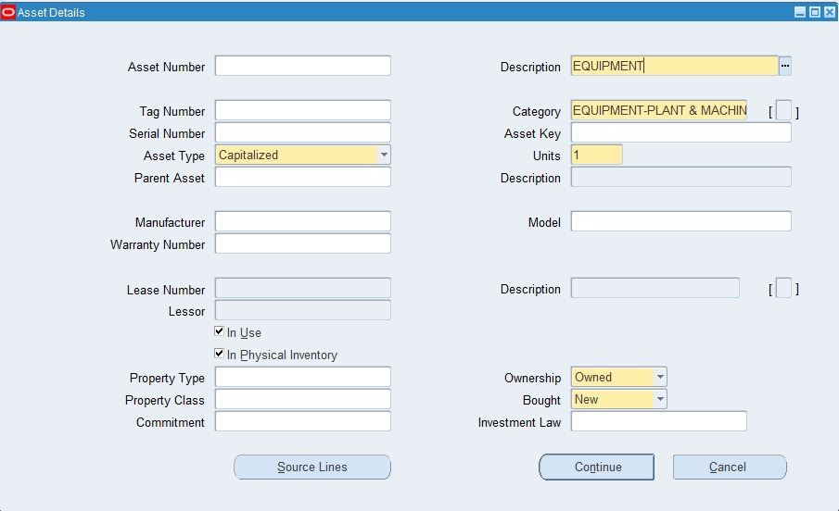

Slide 14
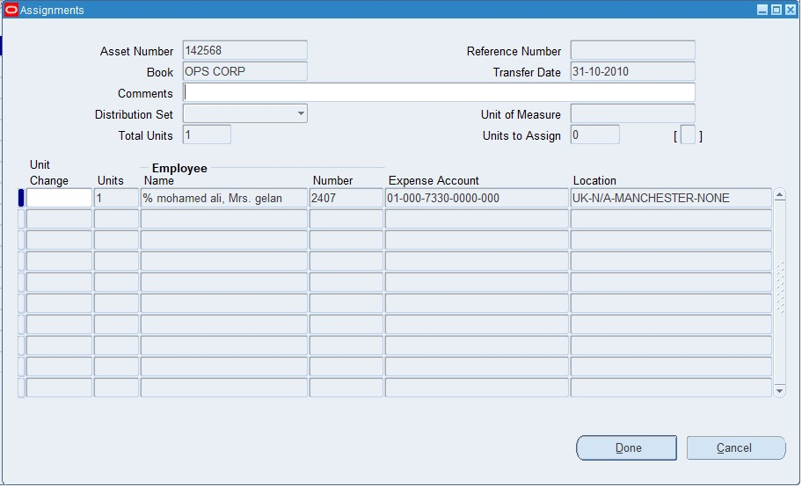

Slide 15
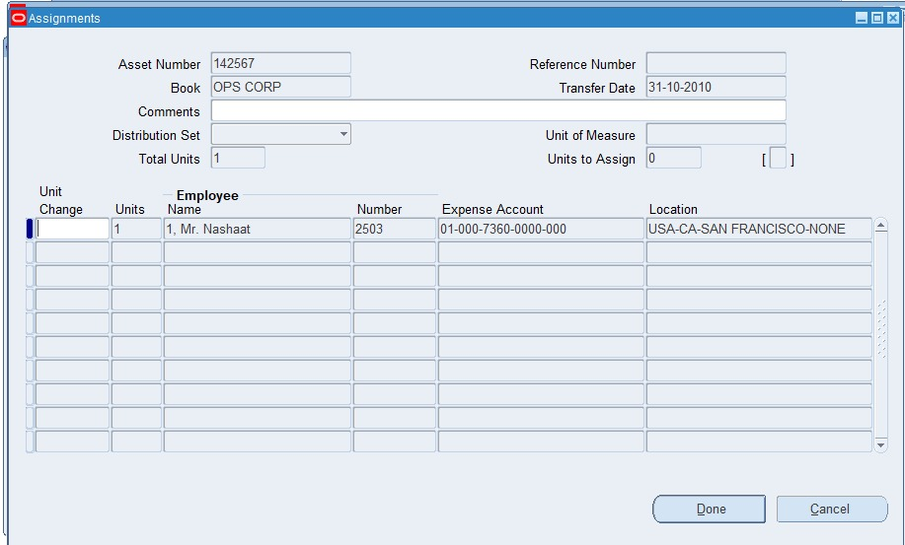

Slide 16
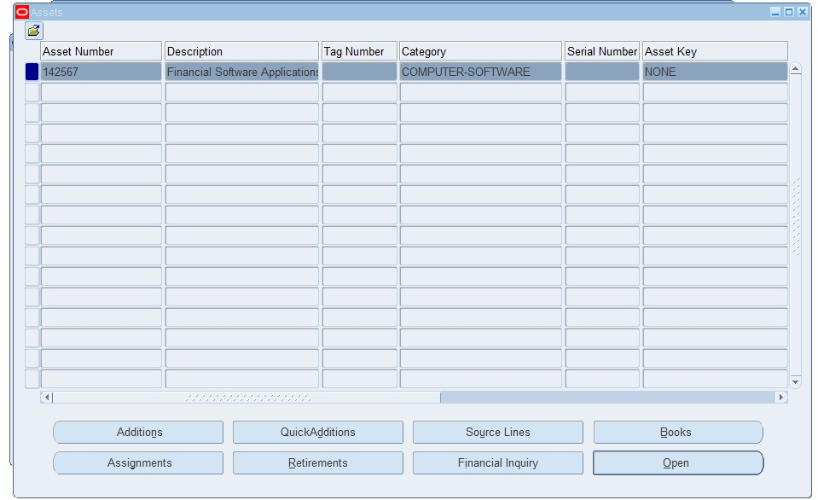

Slide 17
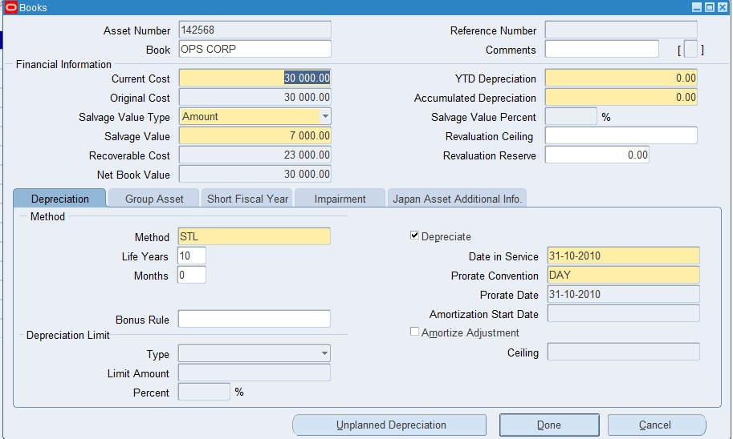

Slide 18
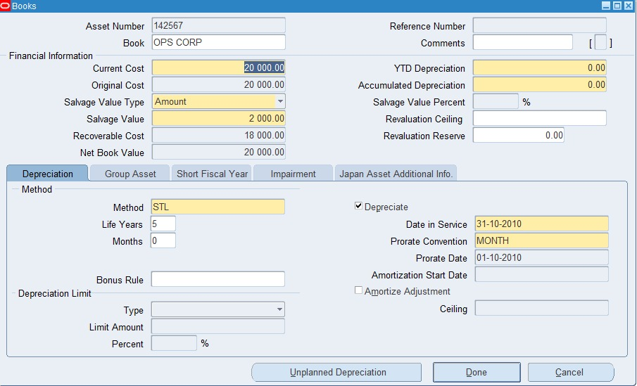

Slide 19
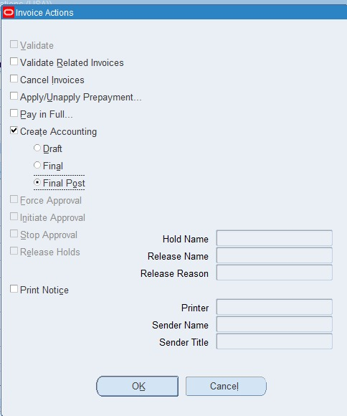

Slide 20
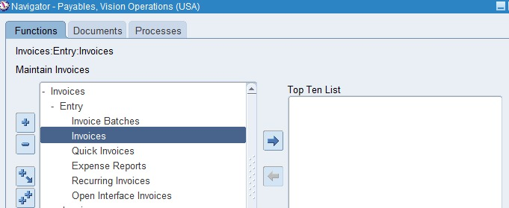

Slide 21
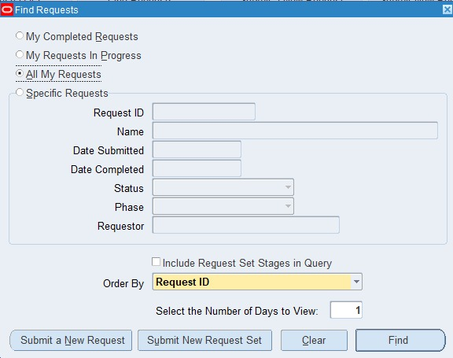

Slide 22
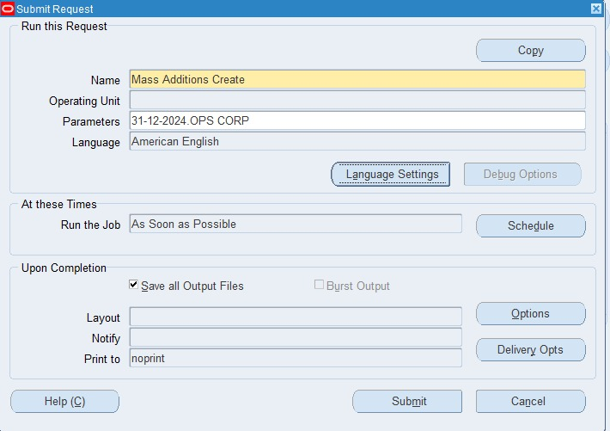

Slide 23
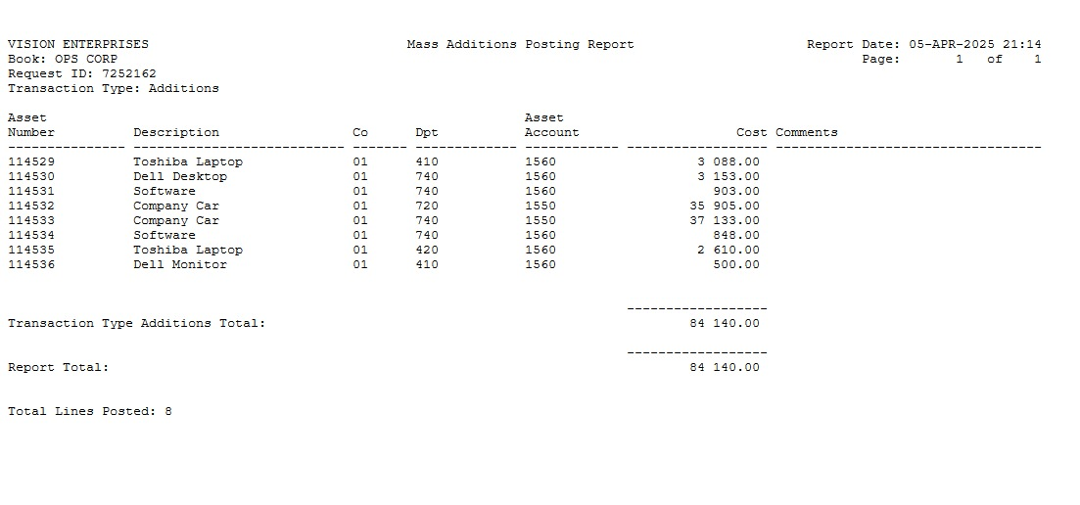

Slide 24
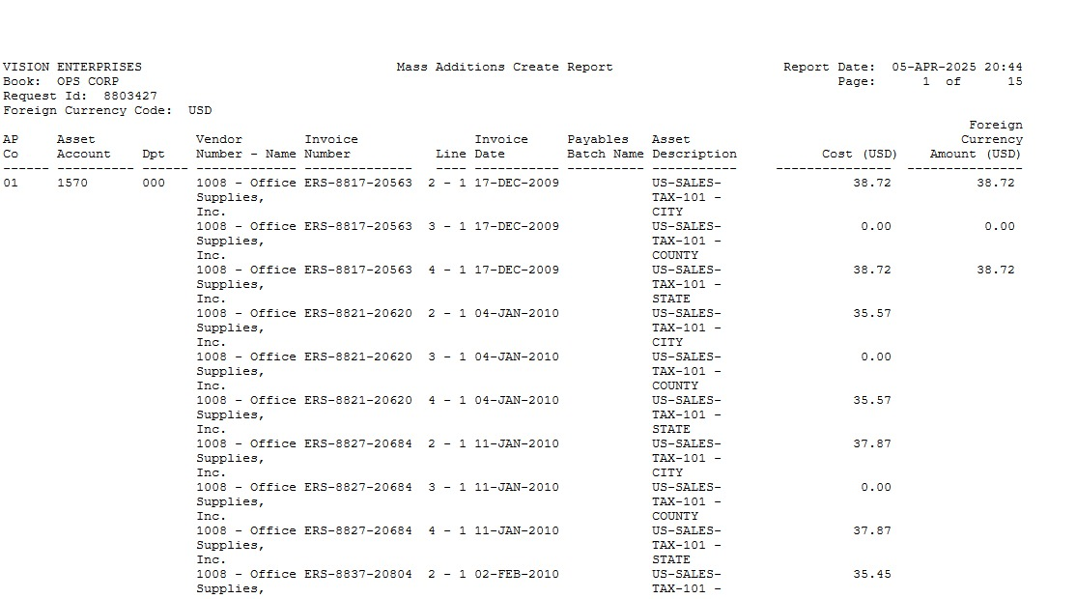

Slide 25
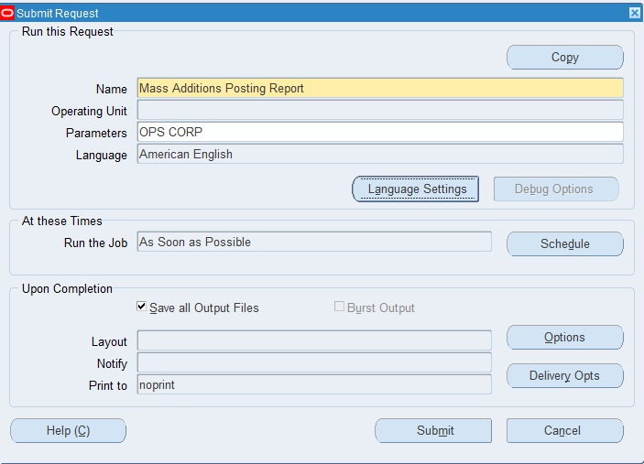

Slide 26
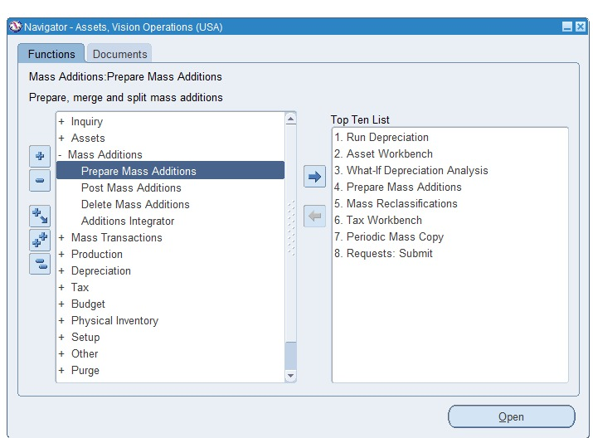

Slide 27
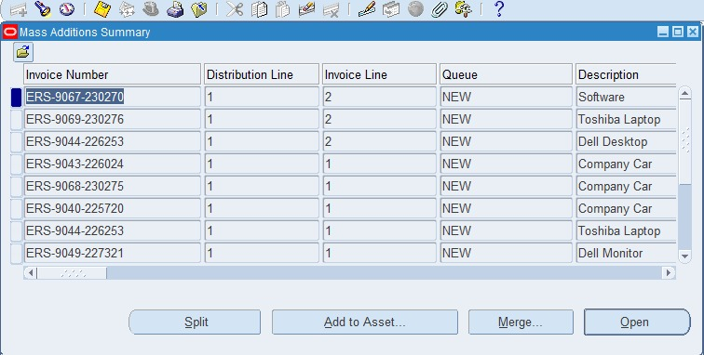

Slide 28
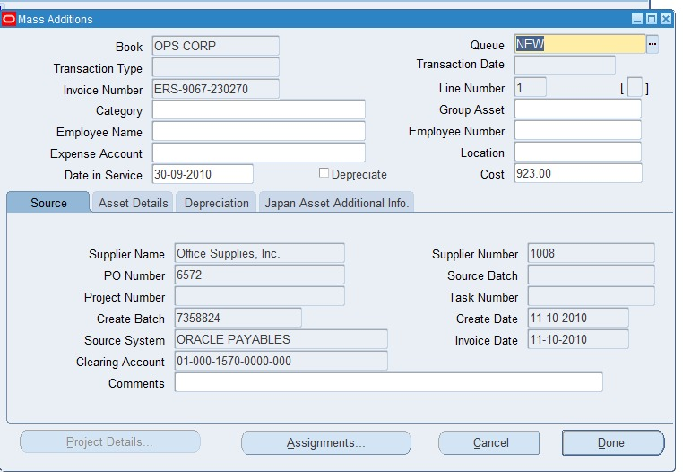

Slide 29
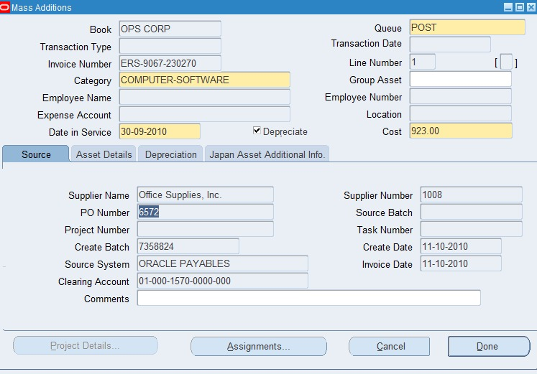

Slide 30
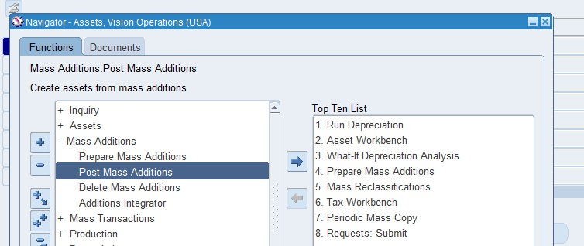

Slide 31
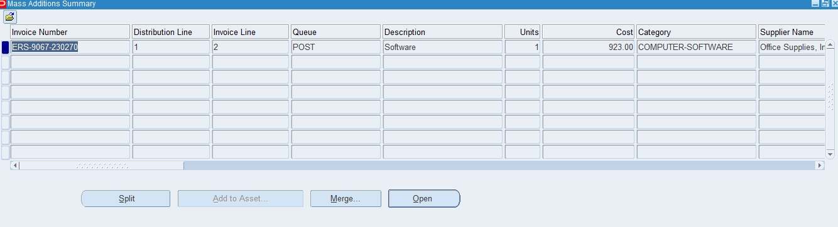

Slide 32
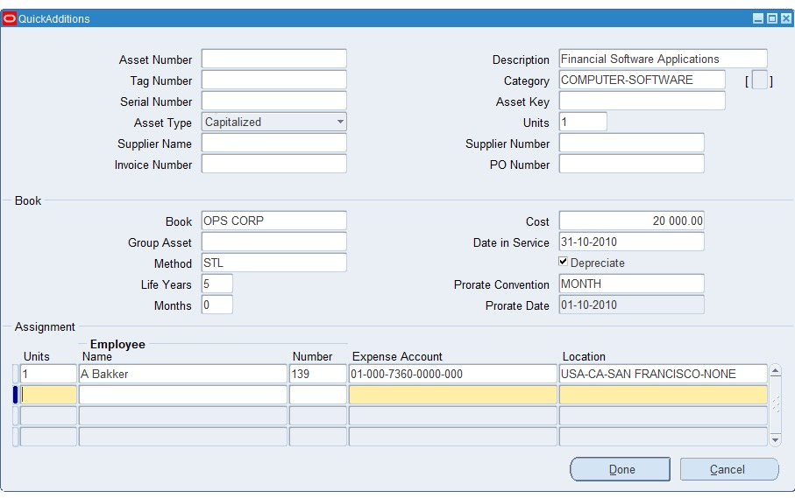

Slide 33
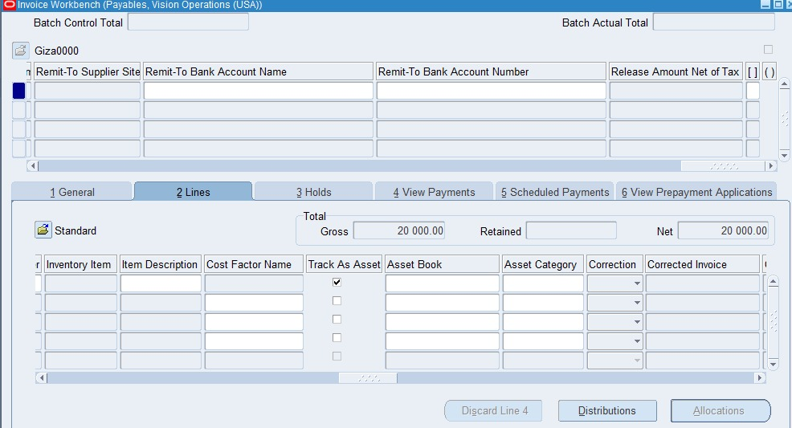

Slide 34
Managing Assets
Assets Details and Financial Inquiry
Assets Transfer and Adjustment
Assets Depreciation and Retirement

Slide 35
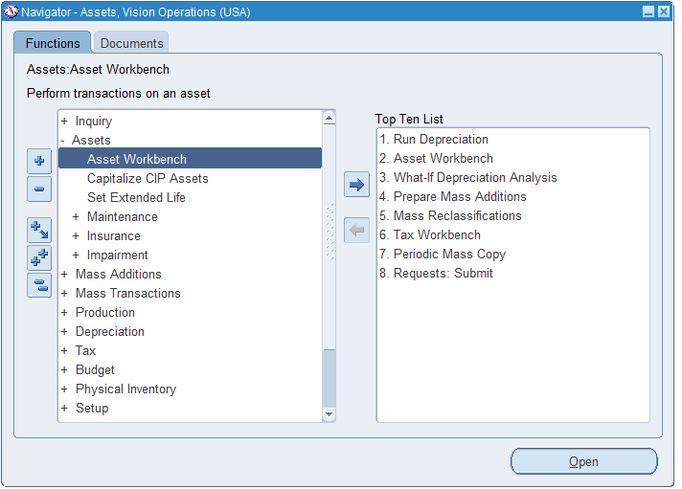

Slide 36
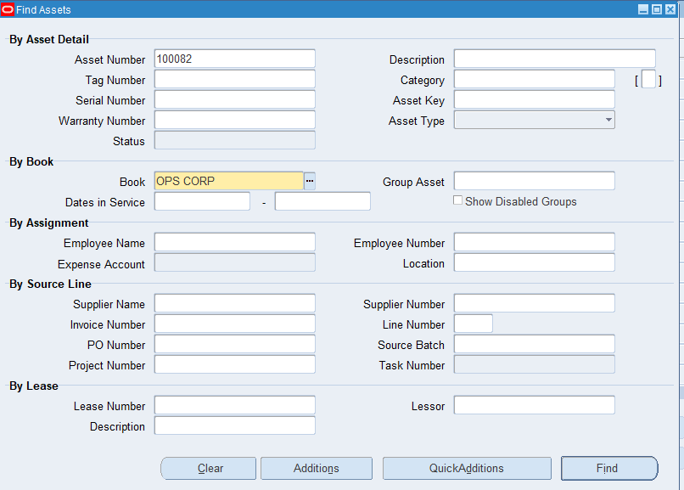
Assets Vision Operations >> Assets Workbench
Assets Workbench >> Find

Slide 37
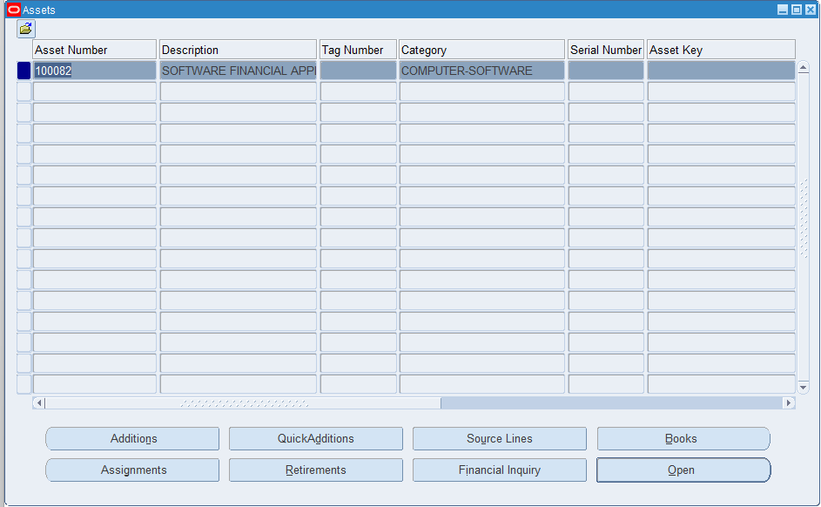
Assets Vision Operations >> Assets Workbench
Assets Workbench >> Find

Slide 38
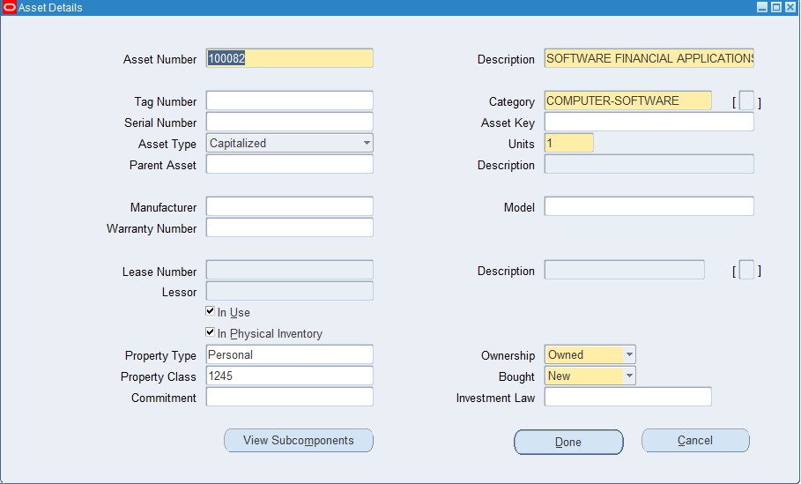
Assets Vision Operations >> Assets Workbench
Assets Workbench >> Find
Assets >> Open

Slide 39
Assets Vision Operations >> Assets Workbench
Assets Workbench >> Find

Slide 40
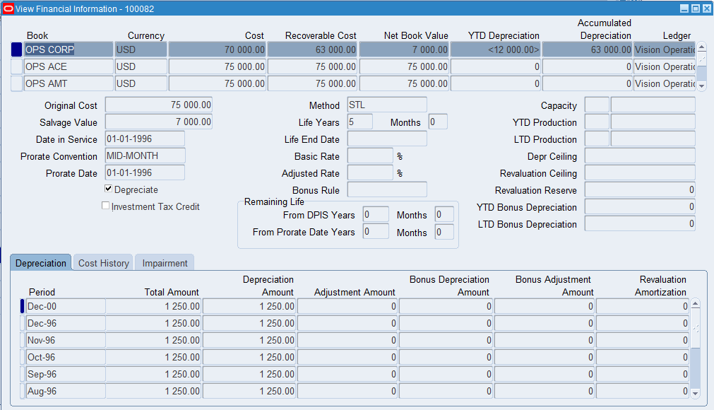
Assets Vision Operations >> Assets Workbench
Assets Workbench >> Find
Assets >> Financial Inqiury

Slide 41
Assets Vision Operations >> Assets Workbench
Assets Workbench >> Find

Slide 42
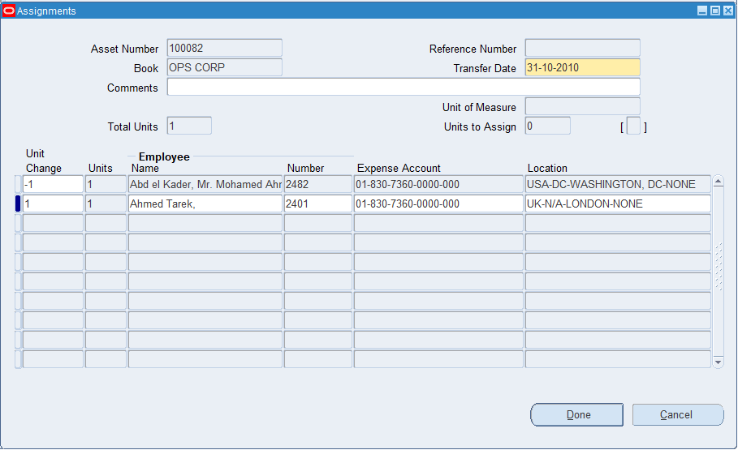
Assets Vision Operations >> Assets Workbench
Assets Workbench >> Find
Assets >> Assignments

Slide 43
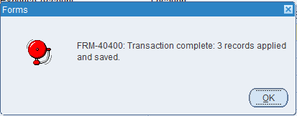
Assets Vision Operations >> Assets Workbench
Assets Workbench >> Find
Assets >> Assignments
Assignments >> Done

Slide 44
Assets Vision Operations >> Assets Workbench
Assets Workbench >> Find

Slide 45
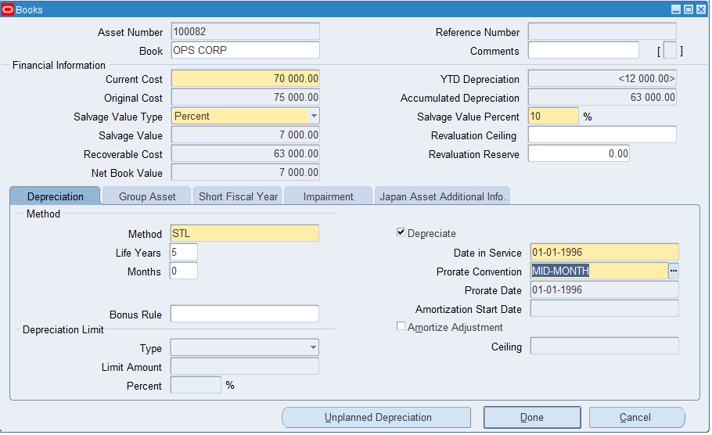
Assets Vision Operations >> Assets Workbench
Assets Workbench >> Find
Assets >> Books

Slide 46
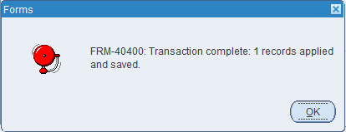
Assets Vision Operations >> Assets Workbench
Assets Workbench >> Find
Assets >> Books
Books >> Done

Slide 48
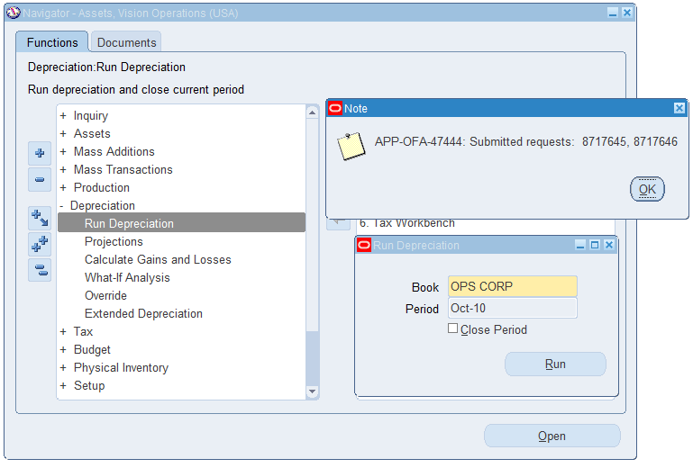
Assets Vision Operations >>
Depreciation >> Run Depreciation
Run Depreciation >> Run

Slide 49
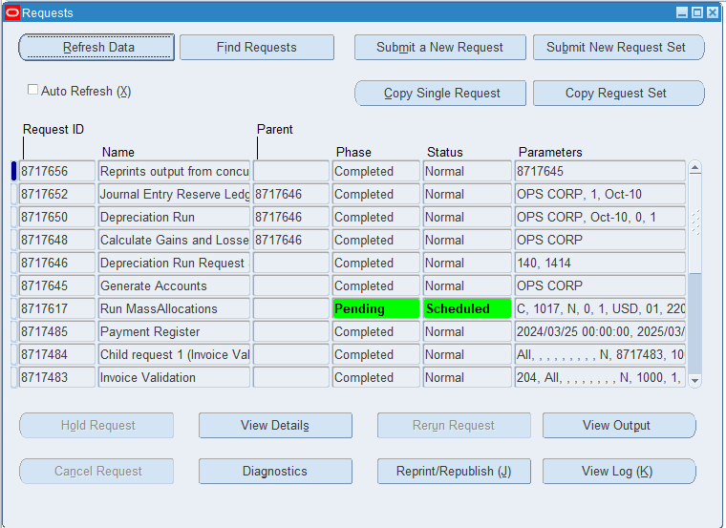
From the top menu bar >> View >> Requests

Slide 50
Final assset
Manage Retirement to assets
Reconciled with the General Ledger

Slide 51
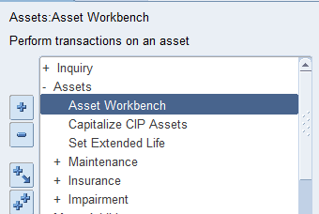
manage retirements
Assets >>asset workbench

Slide 52
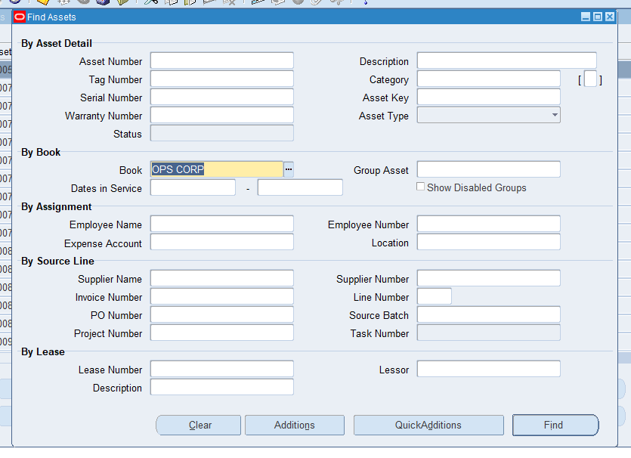
Serch by book
Ops corp > find

Slide 53
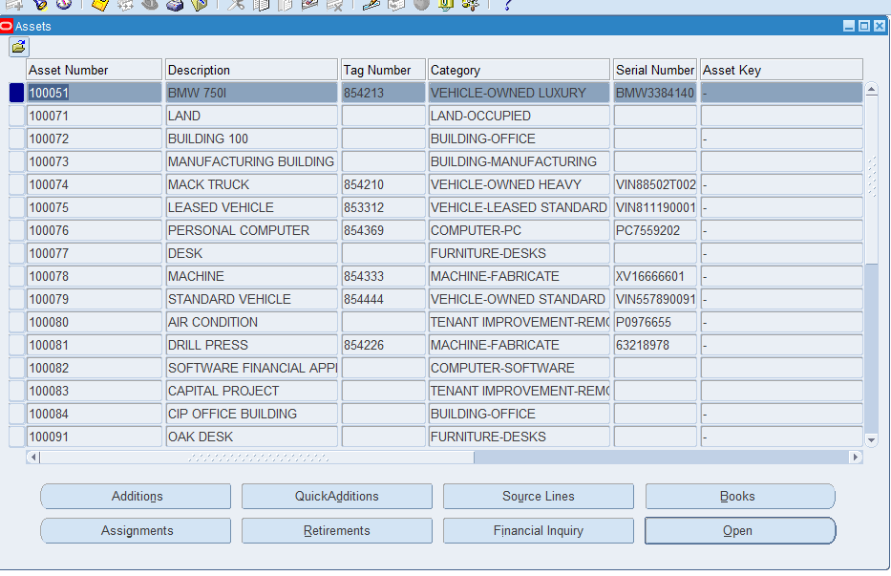

Slide 54
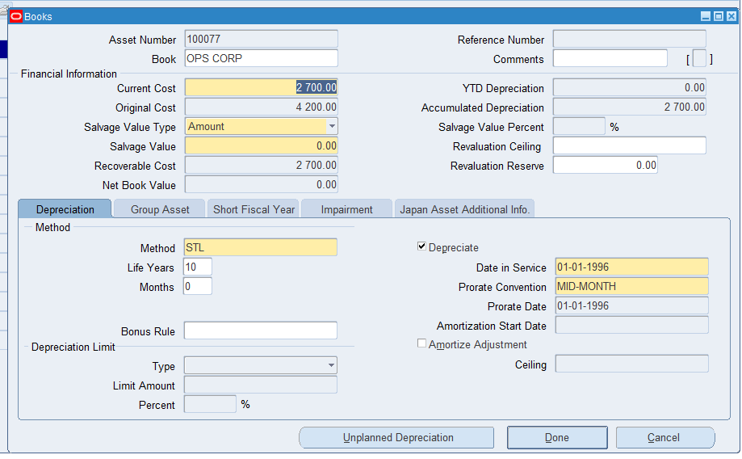
Chose book
We chose the number of asset 100077 to see the current cost to make the retirement ,and see if the asset use for another retirement cicle or not (original cost )

Slide 55
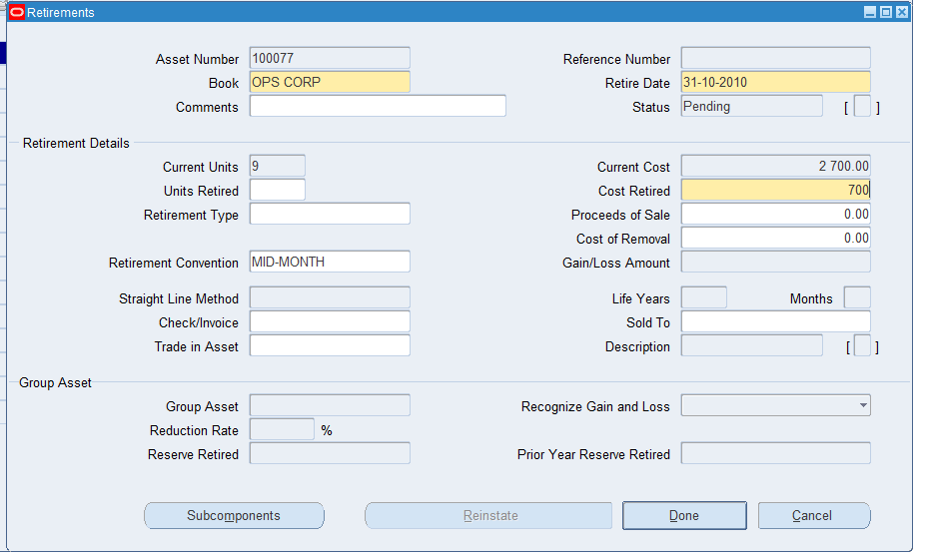
Chose retirement box
You can retired the asset with unit , with cost

Slide 56
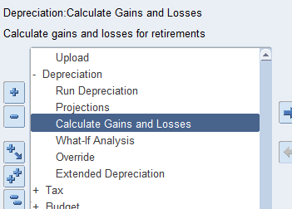
We go to calculate gain &loss
Depreciations > calculate gain and loss

Slide 57
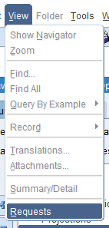
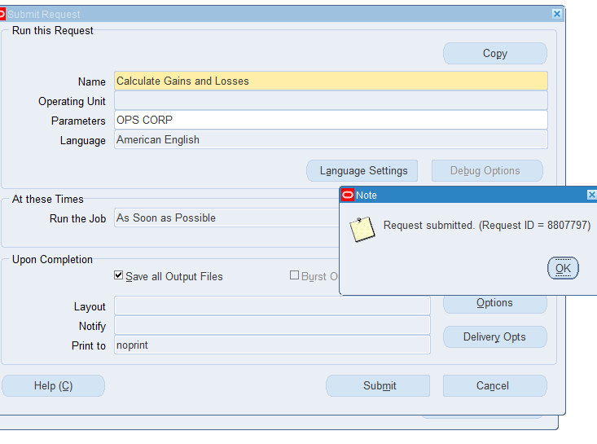
To see output go to
View > requests

Slide 58
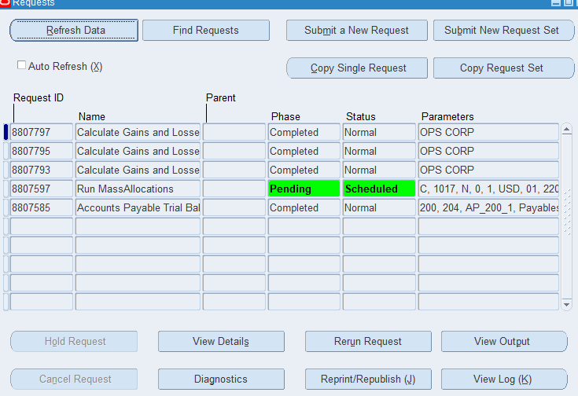
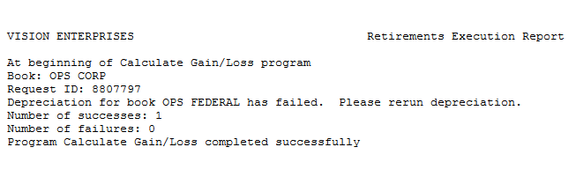
See output

Slide 59



View > requests > submit a new request
Criate request
Asset retirements report

Slide 60

View output

Slide 61


Slide 62

Final we can sending our transactions to the general ledger use
Create accounting

Slide 63



Slide 64


Slide 66
Thank you for your attention.
We now invite any questions or feedback from you.

